Slide 1

UTN-FRGP Ingles 1 Final Presentation

Slide 2




Introduction

Slide 3
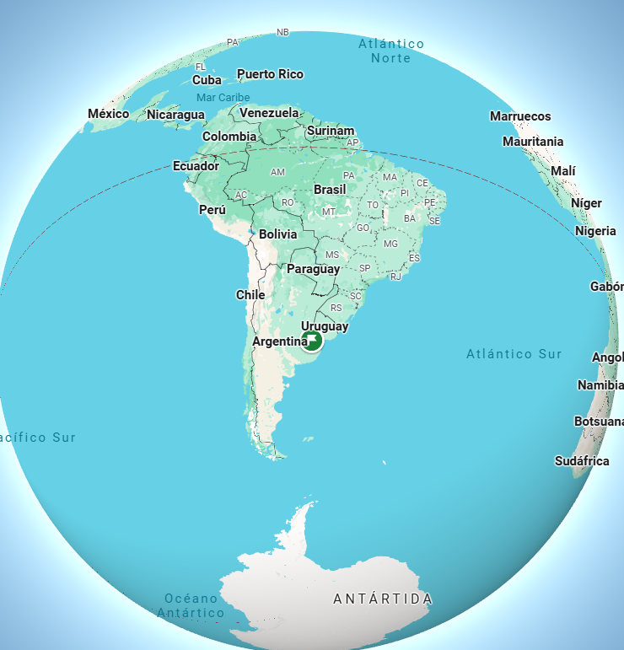

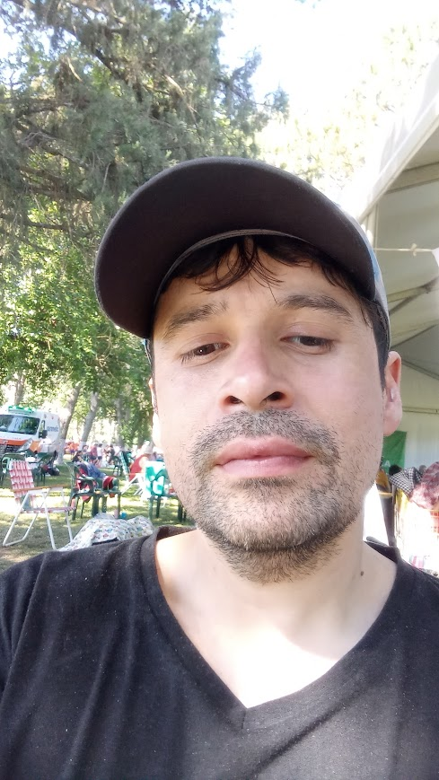
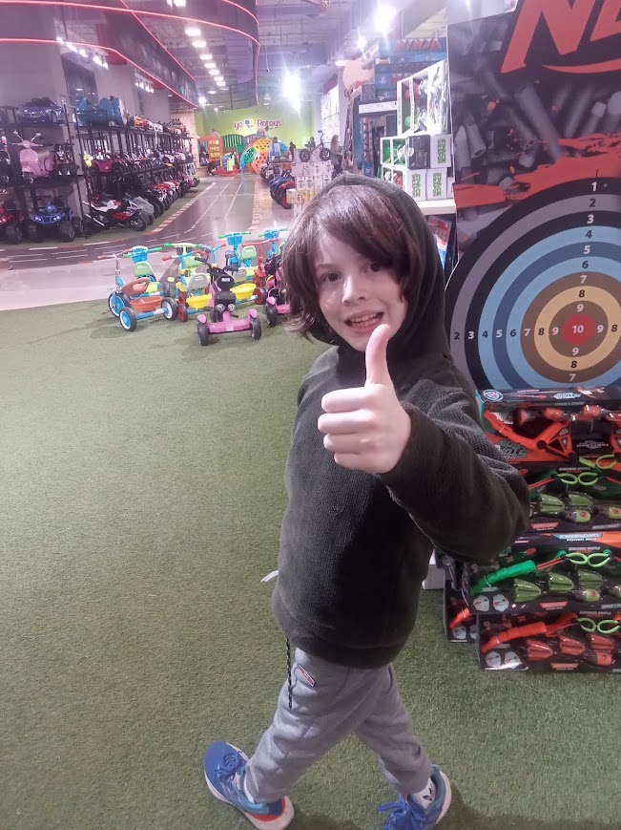
History
El Talar city
dynamic duo programmer-designer

Slide 4

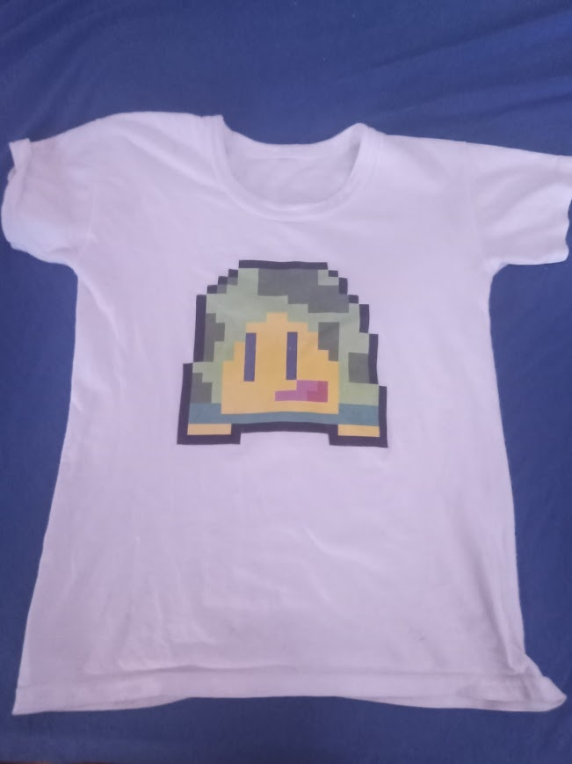
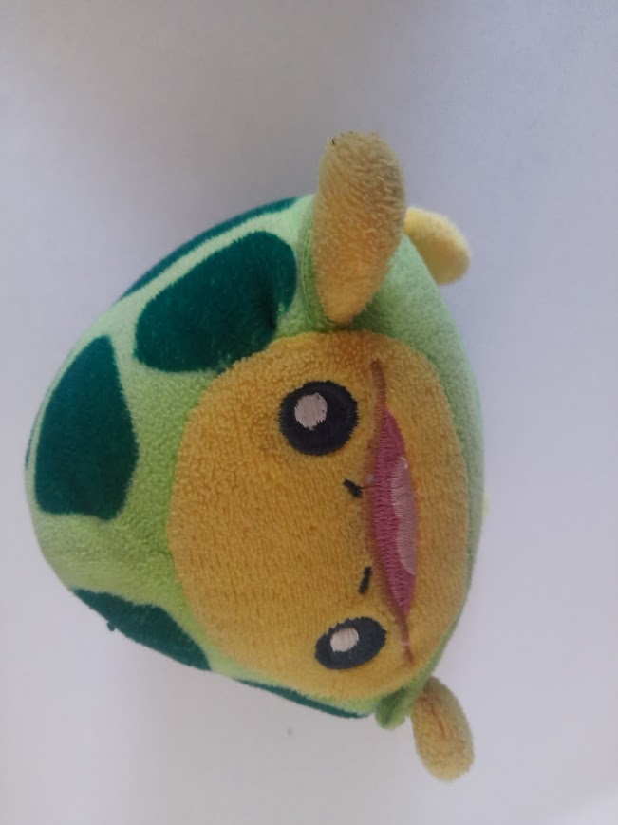
How did the company start its activities?
First Game: Tortuguero Adventure
Expansion market: Merchardise about of Tortuguero

Slide 5


Present
contributes to
Developing app Al Bondi

Slide 6

Thanks

